Slide 1
ADVANCED TREES
Topic 6

Slide 2
Search Trees
Binary Search Trees
Balanced Search Trees
AVL Trees
Splay Trees
(2, 4) Trees
Red-Black Trees

Slide 3
Binary Search Trees

Slide 4
Binary Search Trees
Binary trees are an excellent data structure for storing entries of a map, assuming we have an order relation defined on the keys.
We define a binary search tree as a proper binary tree such that each internal position p stores a key-value pair (k, v) such that:
Keys stored in the left subtree of p are less than k, and
Keys stored in the right subtree of p are greater than k.

Slide 5
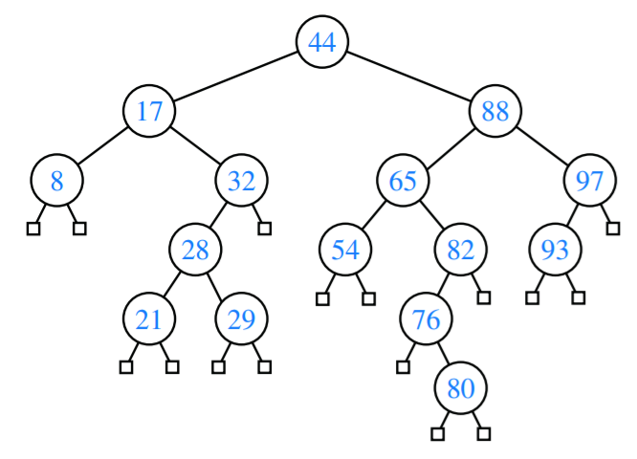
Binary Search Trees
tree.search(65)

Slide 6
Binary Search Trees: Search
We can attempt to locate a particular key in a binary search tree by viewing it as a decision tree.
In this case, the question asked at each internal position p is whether the desired key k is less than, equal to, or greater than the key stored at position p, which we denote as key(p).

Slide 7
Binary Search Trees: Search
If the answer is “less than,” then the search continues in the left subtree.
If the answer is “equal,” then the search terminates successfully.
If the answer is “greater than,” then the search continues in the right subtree.
Finally, if we reach a leaf, then the search terminates unsuccessfully.

Slide 8
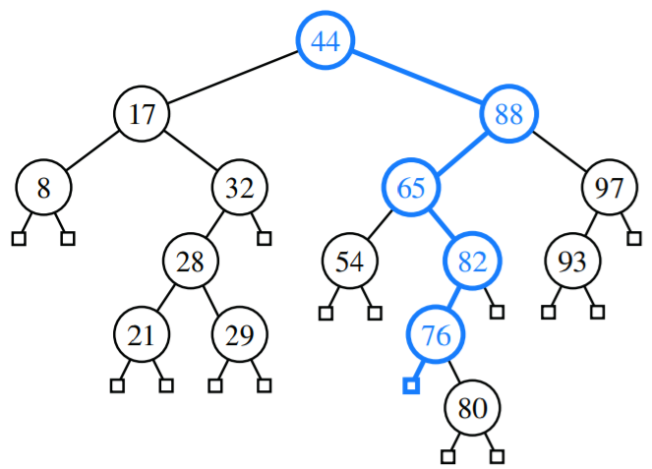
Binary Search Trees: Search
tree.search(68)

Slide 9
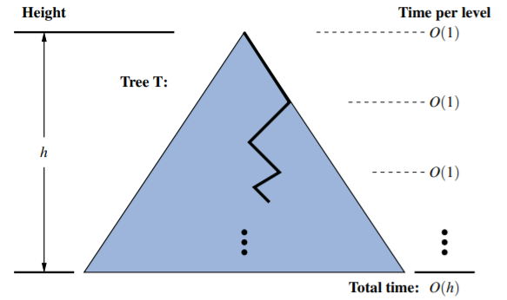
Binary Search Trees: Search Analysis

Slide 10
Binary Search Trees: Insertion
The operation insert(k, v) begins with a search for an entry with key k. If found, that entry’s existing value is reassigned.
Otherwise, the new entry can be inserted into the underlying tree by inserting a new node into its rightful place in the tree via as a child of the result of the searching.

Slide 11
Binary Search Trees: Deletion
Deleting an entry from a binary search tree is a bit more complex than inserting a new entry because the position of an entry to be deleted might be anywhere in the tree (as opposed to insertions, which always occur at a leaf).
To delete an entry with key k, we begin by calling TreeSearch(root( ), k) to find the position p storing an entry with key equal to k (if any).

Slide 12
Binary Search Trees: Deletion
If at most one of the children of position p is internal, the deletion of the entry at position p is easily implemented.
If the position is external, then simply remove the node.
Let position r be a child of p. We will remove p and the leaf that is r’s sibling, while promoting r upward to take the place of p.

Slide 13
Binary Search Trees: Deletion
We locate position r containing the entry having the greatest key that is strictly less than that of position p.
That predecessor will always be located in the rightmost internal position of the left subtree of position p.
We use r’s entry as a replacement for the one being deleted at position p.
Having used r’s entry as a replacement for p, we instead delete the node at position r from the tree.
Fortunately, since r was located as the rightmost internal position in a subtree, r does not have an internal right child. Therefore, its deletion can be performed using the second approach.

Slide 14
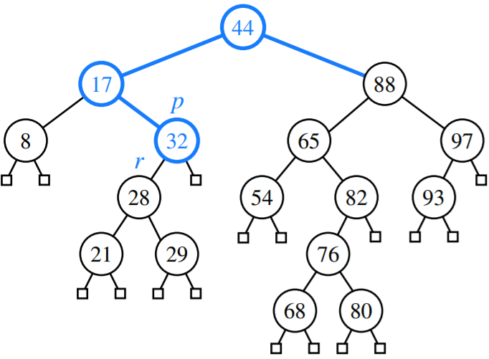
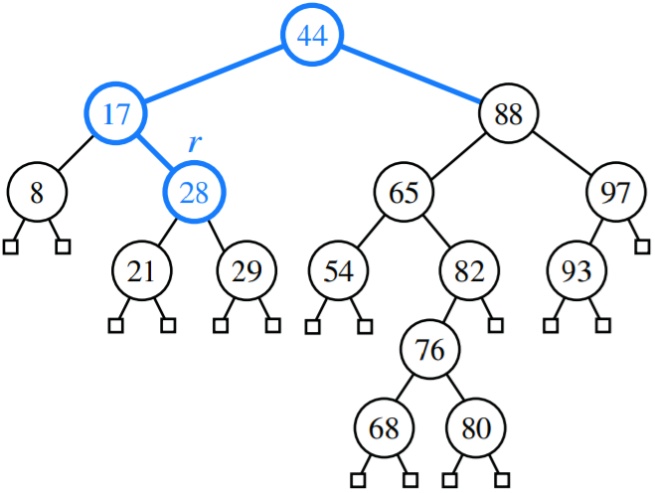
Binary Search Trees: Deletion

Slide 15
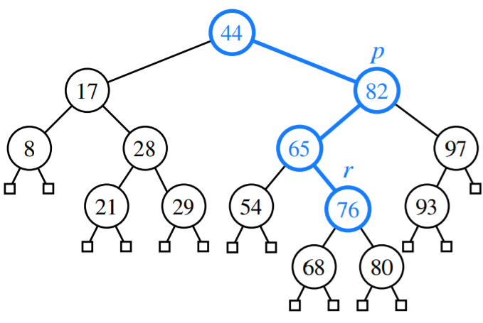
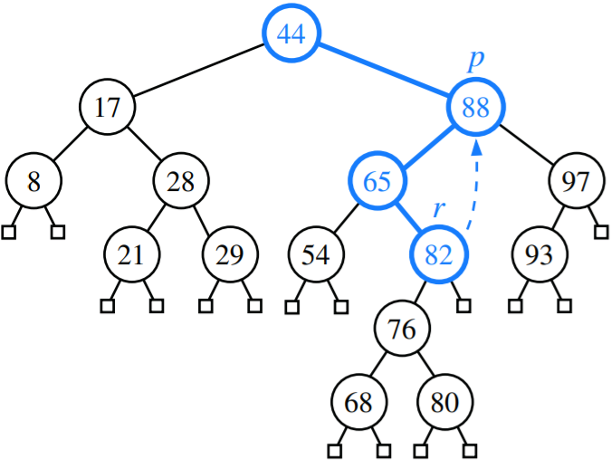
Binary Search Trees: Deletion

Slide 16
Binary Search Trees
A binary search tree T is therefore an efficient implementation of a map with n entries only if its height is small.
In the best case, T has height h = ⌈log(n+1)⌉−1, which yields logarithmic-time performance for most of the map operations.

Slide 17
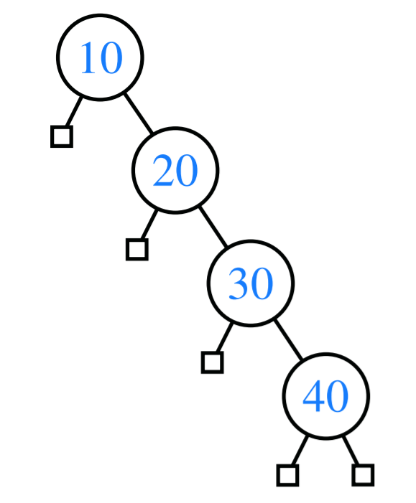
Binary Search Trees
In the worst case, however, T has height n, in which case it would look and feel like an ordered list implementation of a map.
Such a worst-case configuration arises, for example, if we insert entries with keys in increasing or decreasing order.

Slide 18
ACTIVITY

Slide 19
ACTIVITY
Perform the following operation:
insert(52)

Slide 20
ACTIVITY
Perform the following operation:
insert(27)

Slide 21
ACTIVITY
Perform the following operation:
insert(35)

Slide 22
ACTIVITY
Perform the following operation:
insert(17)

Slide 23
ACTIVITY
Perform the following operation:
insert(67)

Slide 24
ACTIVITY
Perform the following operation:
insert(97)

Slide 25
ACTIVITY
Perform the following operation:
remove(35)

Slide 26
ACTIVITY
Perform the following operation:
insert(19)

Slide 27
ACTIVITY
Perform the following operation:
insert(55)

Slide 28
ACTIVITY
Perform the following operation:
remove(67)

Slide 29
ACTIVITY
Perform the following operation:
insert(30)

Slide 30
ACTIVITY
Perform the following operation:
insert(22)

Slide 31
ACTIVITY
Perform the following operation:
insert(34)

Slide 32
ACTIVITY
Perform the following operation:
insert(47)

Slide 33
ACTIVITY
Perform the following operation:
insert(18)

Slide 34
ACTIVITY
Perform the following operation:
remove(27)

Slide 35
ACTIVITY
Perform the following operation:
insert(53)

Slide 36
ACTIVITY
Perform the following operation:
insert(83)

Slide 37
ACTIVITY
Perform the following operation:
insert(10)

Slide 38
ACTIVITY
Perform the following operation:
insert(85)

Slide 39
ACTIVITY
Perform the following operation:
insert(88)

Slide 40
ACTIVITY
Perform the following operation:
insert(4)

Slide 41
ACTIVITY
Perform the following operation:
remove(97)

Slide 42
ACTIVITY
Perform the following operation:
insert(6)

Slide 43
ACTIVITY
Perform the following operation:
insert(70)

Slide 44
ACTIVITY
Perform the following operation:
remove(52)

Slide 45
ACTIVITY
Perform the following operation:
remove(47)

Slide 46
ACTIVITY
Perform the following operation:
insert(8)

Slide 47
ACTIVITY
Perform the following operation:
remove(22)

Slide 48
ACTIVITY
Perform the following operation:
insert(96)

Slide 49
ACTIVITY
Perform the following operation:
insert(2)

Slide 50
Balanced Search Trees

Slide 51
Balanced Search Trees
The worst case time for searches, insertions, and deletions of a binary tree is still O(n) which ultimately defeats the purpose of it being a binary tree.
We will explore four search-tree algorithms that provide stronger performance guarantees.

Slide 52
Balanced Search Trees
The primary operation to rebalance a binary tree is known as rotation.
During a rotation, we rotate a child to be above its parent.

Slide 53
Balanced Search Trees: Rotation
y
x
T₃
T₁
T₂

Slide 54

Balanced Search Trees
In the context of a tree-balancing algorithm, a rotation allows the shape of a tree to be modified while maintaining the search-tree property.
If used wisely, this operation can be performed to avoid highly unbalanced tree configurations.
For example, a leftward rotation of this tree reduces the height of the tree by one.

Slide 55
Balanced Search Trees
One or more rotations can be combined to provide broader rebalancing within a tree.
One such compound operation we consider is a trinode restructuring.
We consider a position x, its parent y, and its grandparent z.
The goal is to restructure the subtree rooted at z in order to reduce the overall path length to x and its subtrees.

Slide 56
Balanced Search Trees: restructure()
Let (a, b, c) be a left-to-right (inorder) listing of the positions x, y, and z, and let (T1, T2, T3, T4) be a left-to-right (inorder) listing of the four subtrees of x, y, and z not rooted at x, y, or z.
Replace the subtree rooted at z with a new subtree rooted at b.
Let a be the left child of b and let T1 and T2 be the left and right subtrees of a, respectively.
Let c be the right child of b and let T3 and T4 be the left and right subtrees of c, respectively

Slide 57
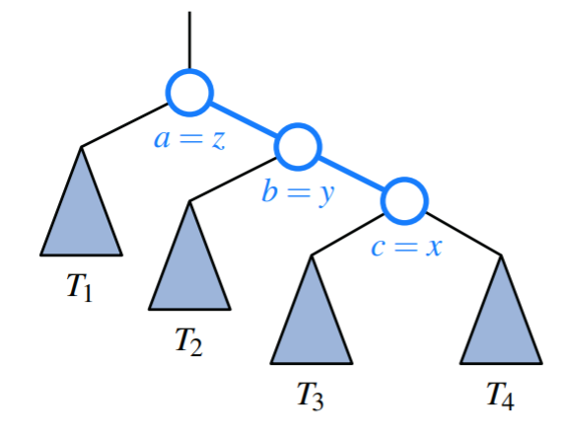
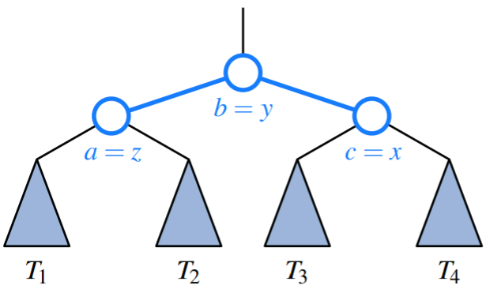
Balanced Search Trees: Zig Left

Slide 58
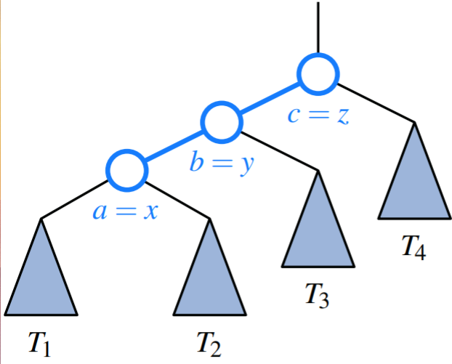
Balanced Search Trees: Zig Right

Slide 59
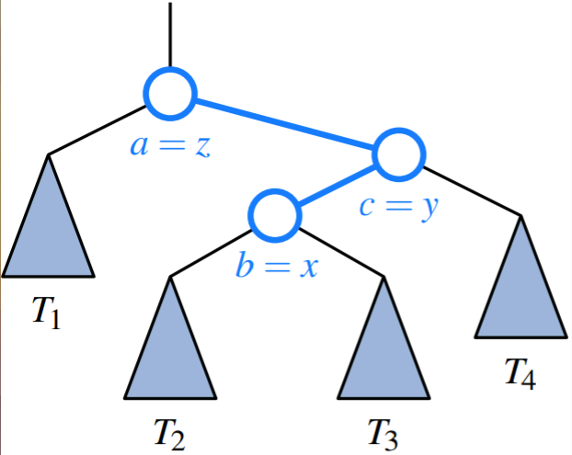
Balanced Search Trees: Zig Zag Left

Slide 60
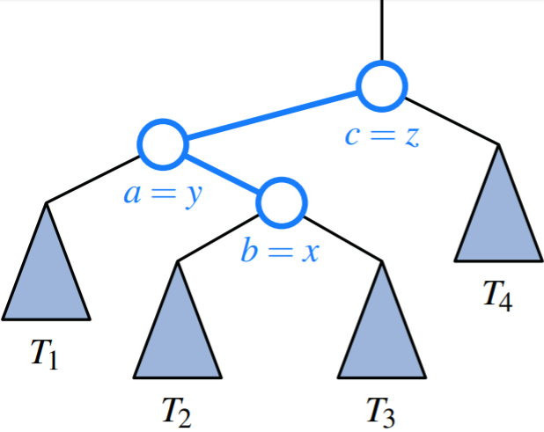
Balanced Search Trees: Zig Zag Right

Slide 61
AVL Trees
AVL Lavigne

Slide 62
AVL Trees
The simple correction is to add a rule to the binary search-tree definition that will maintain a logarithmic height for the tree.
Height-Balance Property: For every internal position p of T, the heights of the children of p differ by at most 1.
Why AVL?
This property is credited to the inventors Adel’son-Vel’skii and Landis.

Slide 63
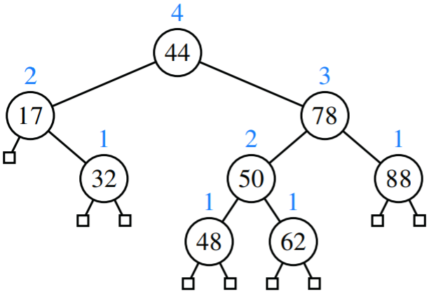
AVL Trees

Slide 64
AVL Trees: Updating
Given a binary search tree T, we say that a position is balanced if the absolute value of the difference between the heights of its children is at most 1, and we say that it is unbalanced otherwise.
Thus, the height-balance property characterizing AVL trees is equivalent to saying that every position is balanced

Slide 65
AVL Trees: Insertion
The insertion and deletion operations for AVL trees begin similarly to the corresponding operations for (standard) binary search trees, but with post-processing for each operation to restore the balance of any portions of the tree that are adversely affected by the change.

Slide 66
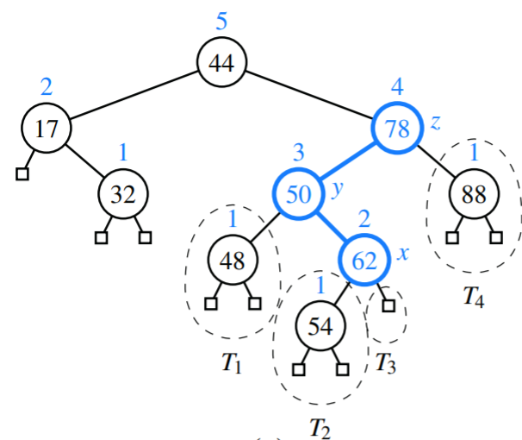
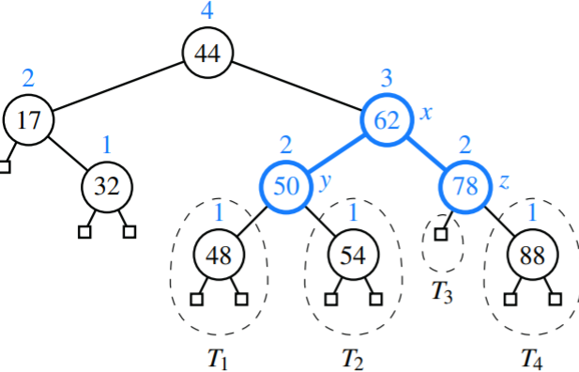
AVL Trees: Insertion

Slide 67
AVL Trees: Deletion
If position p represents a (possibly external) child of the removed node in tree T, there may be an unbalanced node on the path from p to the root of T.
In fact, there can be at most one such unbalanced node.

Slide 68
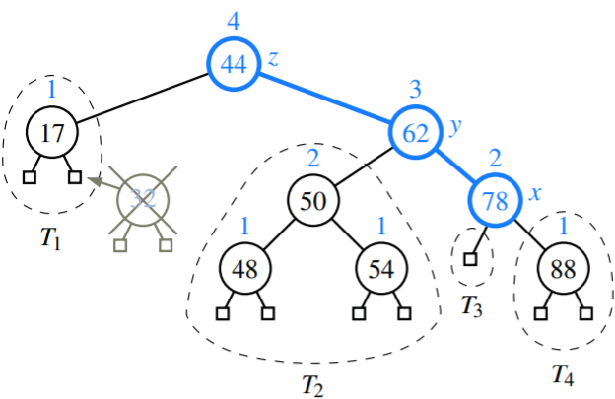
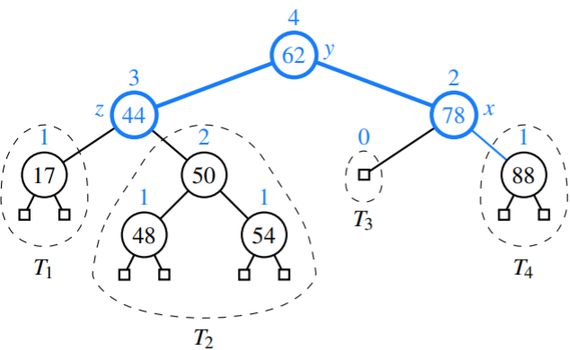
AVL Trees: Deletion

